Slide 1
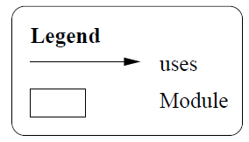
Overall
BBD-V (Mobile Devices)
BBD-Ops (Central Managing Service)
BBD-M (Journey Information)

Slide 2
BBD-V
Send vehicle speed/location
JSON Encoder/decoder
WKWYL GPS API
Send on-line driver registration
Send on-line vehicle registration
Encode vehicle location/speed
Encode on-line driver registration
Encode on-line vehicle registration

Slide 3
Send Unauthorised access report
BBD-Ops
Authorisation logic
Process Journey report
Receive journey report request
Decode vehicle location/speed
Encode Unauthorised access report
Decode journey report request
Unauthorised report access repository
Send journey report
Process Vehicle Location/Speed
Driver Behaviour
Monitor
Police IT RESTful API
Journey Report Repository
Vehicle Location/speed repository
Real-time tracking logic
Encode Journey report
Decode on-line driver registration
Process on-line driver registration
Process on-line vehicle registration
Decode on-line vehicle registration
On-line driver registration repository
On-line vehicle registration repository

Slide 4
BBD-M
Send journey report request
Display journey report
Encode journey report request
Receive journey report
Decode journey report received

Slide 5
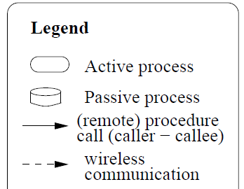
WKWYL GPS API
Send on-line driver registration
Send on-line vehicle registration
“Process” Structure
BBD-Ops
Encode on-line driver registration
Encode on-line vehicle registration
Send vehicle speed/location
Process Vehicle Location/Speed
Vehicle Location/speed repository
Driver Information
Driver Behaviour Monitor

Slide 6
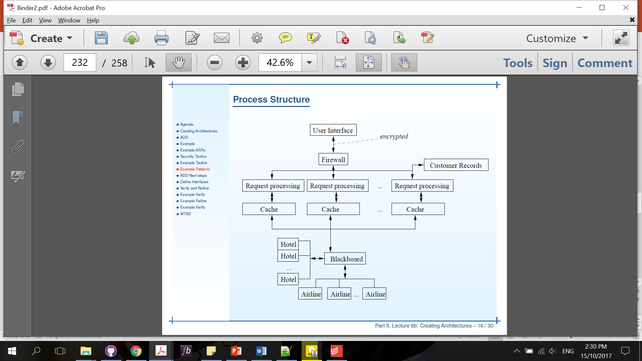
“Process” Structure
BBD-Ops

Slide 7
Layered structure
Presentation
Application
Database
BBD-OpS
BBD-OpS
BBD-OpS

Slide 8
“Process” Structure
BBD-M

Slide 9
Send vehicle Location/speed
Process on-line registration
Encode/decode vehicle location/speed
Process vehicle location/speed
Estimator
Send on-line registration
Vehicle location/speed repository
Process vehicle Location/speed
Real time tracking
GPS module
Broker
WKWYL API
Journey Information Repository
Reporting to Police
Reporting to NZTA
Driver Information
Operations
History
Process report
Generate report
Operations

